Slide 1
OOA

Slide 2
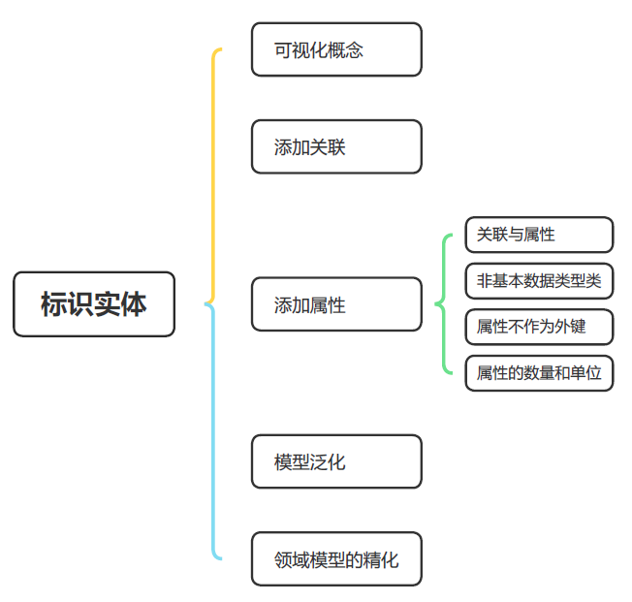

Slide 3
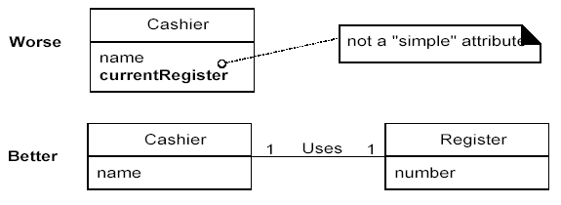
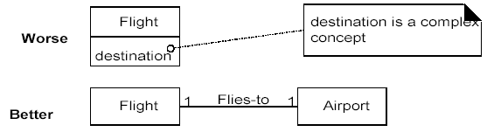
属性和关联
属性最好是简单的属性和数据类型

Slide 4
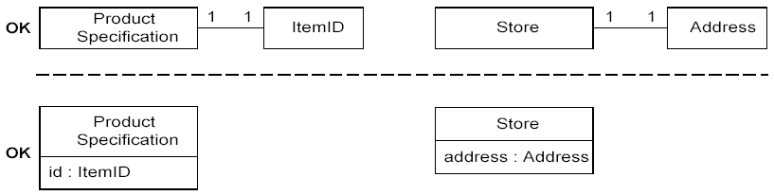
非基本数据类型类
如果属性类是一种数据类型，则该属性类可直接置于属性框。

Slide 5
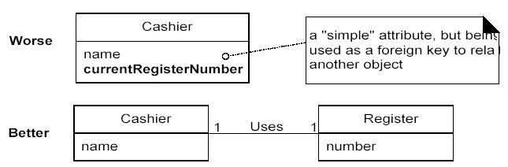
属性不作为外键
在领域模型中，属性不应用于关联概念类

Slide 6
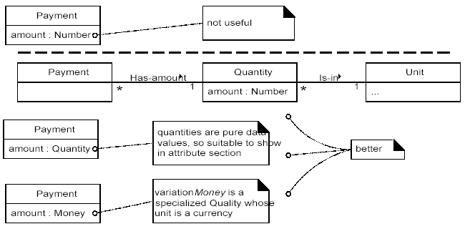
属性的数量和单位
绝大多数数值型的量不应单纯地视为数值

Slide 7
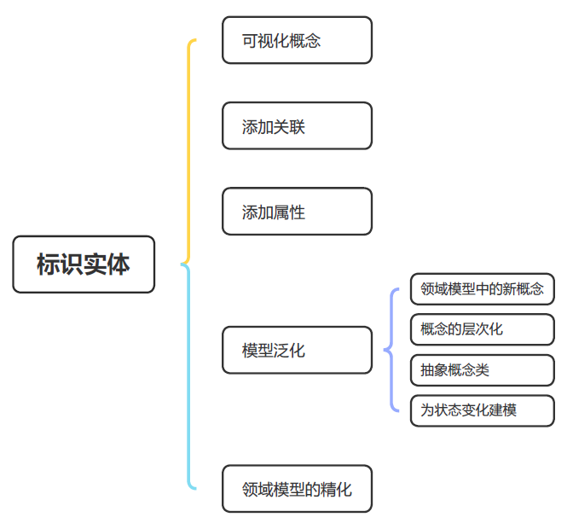

Slide 8
类型概念列表
Category | Examples
physical or tangible objects | CreditCard, Check
Transactions | CashPayment, CreditPayment, CheckPayment
other computer or electro-mechanical systems external to our system | CreditAuthorizationService, CheckAuthorizationService
abstract noun concepts
organizations | CreditAuthorizationService, CheckAuthorizationService
records of finance, work, contracts, legal matters | AccountsReceivable

Slide 9
用例中的名词标示
Use Case UC1: Process Sale
7b. Paying by credit:
1. Customer enters their credit account information.
2. System sends payment authorization request to an external Payment Authorization Service System, and requests payment approval.
2a. System detects failure to collaborate with external system:
        1. System signals error to Cashier.
        2. Cashier asks Customer for alternate payment.
3. System receives payment approval and signals approval to Cashier.
3a. System receives payment denial:
  1. System signals denial to Cashier.
  2. Cashier asks Customer for alternate payment.
4. System records the credit payment, which includes the payment approval.
5. System presents credit payment signature input mechanism.
6. Cashier asks Customer for a credit payment signature. Customer enters signature.

Slide 10
Use Case UC1: Process Sale
7c. Paying by check:
1. The Customer writes a check, and gives it and their driver's license to the Cashier.
2. Cashier writes the driver's license number on the check, enters it, and requests check payment authorization.
3. Generates a check payment request and sends it to an external Check Authorization Service.
4. Receives a check payment approval and signals approval to Cashier.
5. System records the check payment, which includes the payment approval.

Slide 11
概念类的层次化(1/3)
抽象与具体
整体与部分

Slide 12
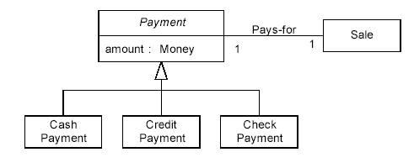
概念类的层次化（2/3）
子类必须在属性和关联上保持一致性

Slide 13
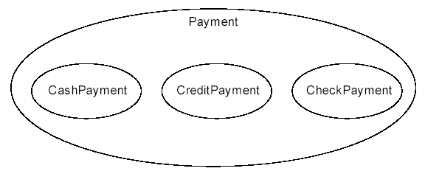
概念类的层次化（3/3）
CreditPayment 应该是Payments集合的成员。
CheckPayment是一种 Payment类型。
Is-a Rule
  所有子类集合的成员必须是父类集合的成员。

Slide 14
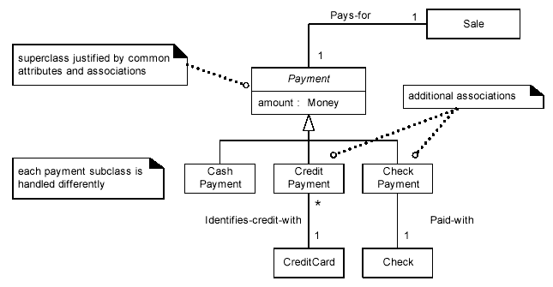
实例-- NextGen POS

Slide 15
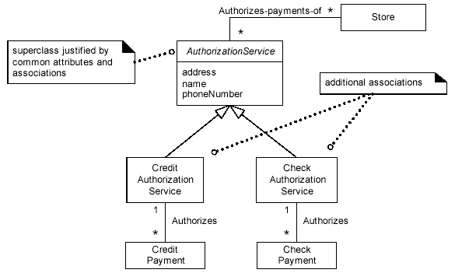

Slide 16
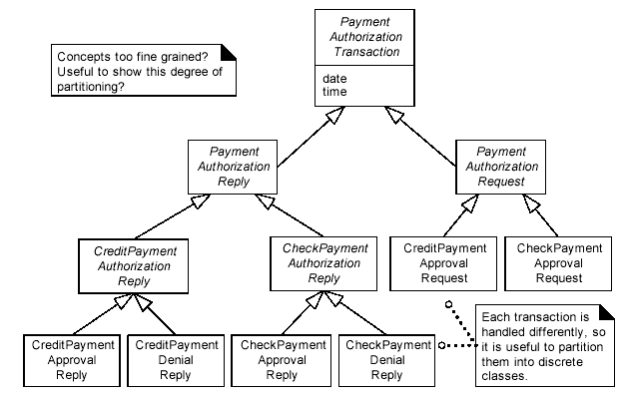
问题：概念被分得太细吗？

Slide 17
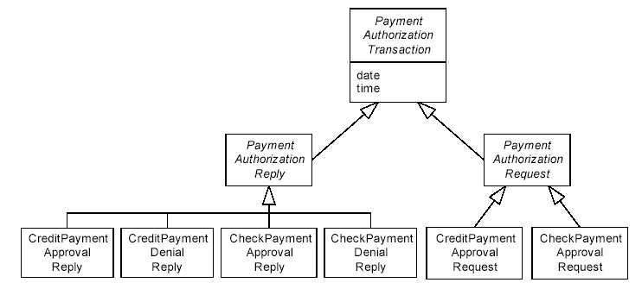

Slide 18
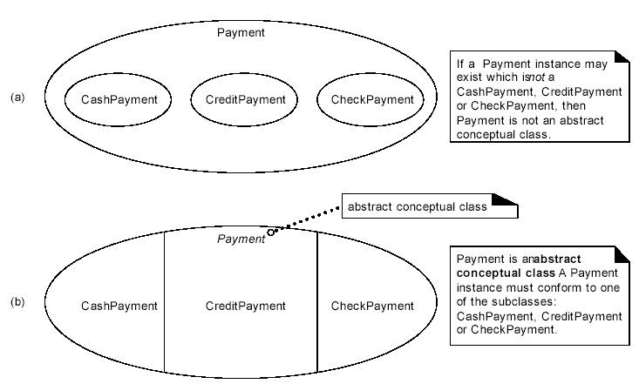
抽象概念类

Slide 19
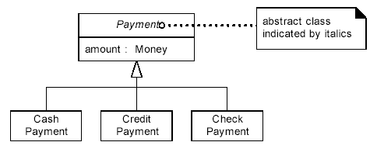
UML中的抽象类

Slide 20
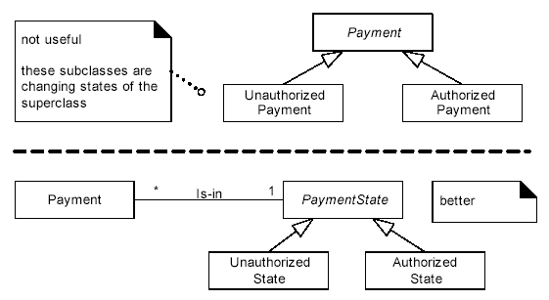
变化状态建模（modeling changing state）
不要以子类的形式为变化的状态建模

